Slide 1

Dynamic Human Emotion Recognition
Submitted by:
Nishant Chauhan
2021EET2377
Under the guidance of:
Prof. Tapan Kumar Gandhi
Department of Electrical Engineering
IIT Delhi

Slide 2
INTRODUCTION
Facial expression recognition from static images is a challenging computer vision problem.
Facial expression has a lot of real world application in real world.
In this project, we have used transfer learning technique and a sequential CNN model in order to create a model capable of recognizing the human facial expression.
Finally we use the trained model, and create a quantized model from this and compare the results.

Slide 3







Dataset
The dataset that we have used is: Ck+ dataset(981 images)
In 2000, the Cohn-Kanade (CK) database was released for the purpose of promoting research into automatically detecting individual facial expressions.
Angry Neutral Disgust Fear Happy Sad Surprise

Slide 4
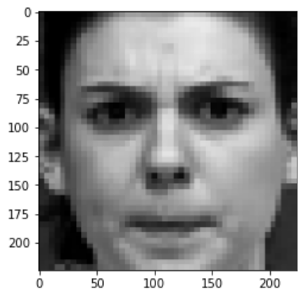
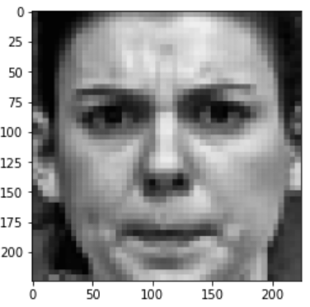
Image Pre-processing : CLAHE(Contrast Limited Adaptive Histogram Equalization)
Histogram equalization is one of the tools we have for image pre-processing.
The reason we need histogram equalization is that when we collect images that are washed out or images with low contrast, we can stretch the histogram to span the entire range.
Variant of adaptive histogram equalization
It does histogram equalization in small patches with high accuracy and considering local contrast.

Slide 5
Image Pre-processing : Face Crop
Now our next target is to get the cropped face image.
Using the OpenCV Deep Neural Network module, we will able to detect the faces in a particular image using the Caffe model.
And finally we resize the input image to desired model input size.

Slide 6
Transfer Learning
The reuse of a pre-trained model on a new problem is known as transfer learning in machine learning. A machine uses the knowledge learned from a prior assignment to increase prediction about a new task in transfer learning.
We have used following models:
MobileNet V2
Resnet50
Vgg16

Slide 7
Results for float32
Model Name | Accuracy
Mobile Net | 63.51%
ResNet50 | 72.29%
Vgg16 | 65.54%
Emotion Model | 62.00%

Slide 8
Quantization
The fundamental idea behind quantization is that if we convert the weights and inputs into integer types, we consume less memory and on certain hardware, the calculations are faster.
Types of quantization.
Quantization Aware Training
Post Training Quantization
Advantages:
Lesser model size
Increased computation efficiency

Slide 9

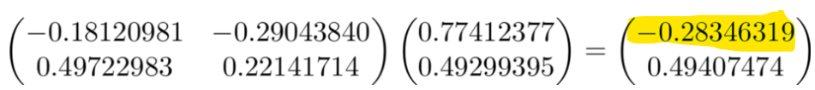
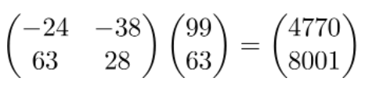

How quantization works?
Suppose we have a layer output in the range [-a,a), where a is any real number. First we scale the output to [-128,128) and then we round down.
Floor of(-0.18120981 * 128) , here a=1 as all values lies in the range (-1,1)
Floor(-23.194) = -24
Since multiplying two 8-bit integers is a 16-bit integer, we can de-quantize the result with the transformation dequantize output = -4770 *1 / 16384 = -0.291137
This difference in the output is quite expected, because of approximation and we loose information during the process.

Slide 10
Results for float16 quantized model
Model | Accuracy(float32) | Accuracy(float16)
MobileNet | 63.51% | 63.51%
Resnet50 | 72.29% | 72.29%
Vgg16 | 65.54% | 65.54%

Slide 11
Results for int8 quantized model
Model | Float32 | Float16 | int8
MobileNet | 63.51% | 63.51% | 57.43%
Resnet50 | 72.29% | 72.29% | 70.34%
Vgg16 | 65.54% | 65.54% | 64.864%

Slide 12
Future Work
The first task will be to improve the accuracy.
Implement on other dataset like jaffe and FER2013.

Slide 13
References
https://www.kaggle.com/datasets/shawon10/ckplus
https://arxiv.org/abs/2104.11274
https://arxiv.org/abs/1804.08348
https://www.tensorflow.org/lite/performance/posttrainingquantization
https://towardsdatascience.com/how-to-accelerate-and-compress-neural-networks-with-quantization-edfbbabb6af7

Slide 14


